Slide 1


Big Data Project
Group: COVID-Extractor
Student: Jerry Gou(jg6226), Chen Chen(cc6475), Guokun Liu(gl1870)
Advisor: Juliana Freire
5/09/2020
Notes:
Hi, good afternoon, everyone, today I want to introduce our project to you.

Slide 2
Problem: Economy Analysis
How does COVID-19 affect the economy of USA?
Among the companies in S&P 500, which are beneficiaries of COVID-19 and which are impacted negatively regarding their stock performance?
Notes:
Our research problem is “How does COVID-19 affect the economy in US?”. To be more specific, we want to find the beneficiaries of the pandemic, and companies are negatively impacted by COVID-19.

Slide 3
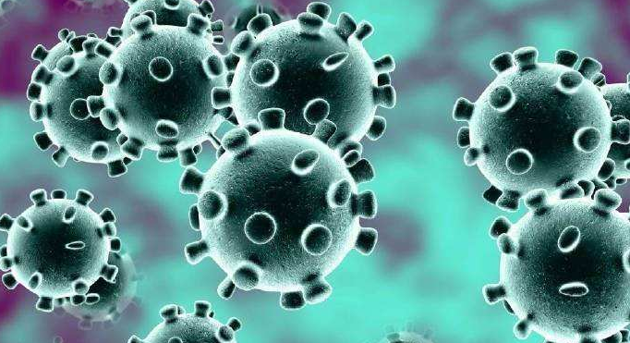

Correlation analysis between COVID-19 cases and stock price
Notes:
Assuming that the larger the new COVID-19 case number is, the worse the situation is. As you know, the rise and decrease of a stock’s price can measure
the situation of the stock. So, we proposed an approach in our project that we compute the correlation between new COVID-19 case number and each stock’s
price to see whether this stock is significantly affected by COVID-19.

Slide 4

Method
i. Correlation coefficient and p-value
The methods to calculate correlation coefficient:
In addition, with “there is no linear relationship between the number of new cases per day and the daily stock price” (which means correlation coefficient r = 0) as the null hypothesis, we can calculate the significance index p-value that measures the null hypothesis is wrong.
In short, the larger the p-value, the more the null hypothesis should be rejected.
Notes:
This is the formulation of the correlation between two variables X and Y. in our case, we have many X, represents the daily close price of each stock, and Y, the daily new covid-19 case number. Don’t forget that, we also compute the p-value between them. It is the probability that X and Y are not correlated. In other words, the smaller the p-value is, we are more confident to say X and Y are correlated.

Slide 5
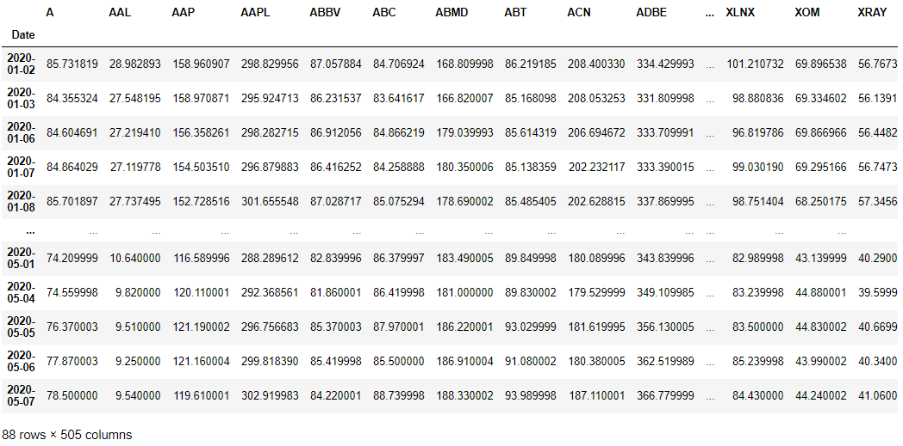
Dataset
i. Stock data of companies in S&P 500
Format: (date, stock ticker 1, stock ticker 2, …… , stock ticker 505)
Content: Daily Adjusted Close Price of each stock between 01/01/2020 and 05/07/2020
Source: https://www.kaggle.com/jacksoncrow/stock-market-dataset
Notes:
Now, let’s get through a little bit into our datasets, firstly, of course, we have daily close price of each stock. As you can see, each row is one day, each column’s name is the ticker or symbol of a stock.

Slide 6
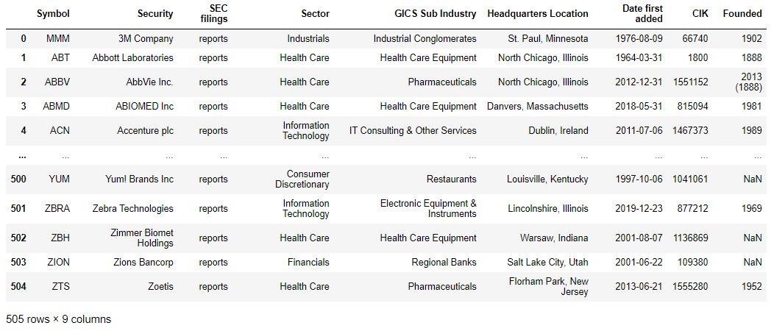
Dataset
ii. Stock Sector information dataset
Format: (stock ticker, Attribute 1, , Attribute 2, ……,GICS sector , …… , Attribute N)
Content: Information on each stock in the S & P 500 (including Global Industry Classification Standard Sector information)
Source: https://en.wikipedia.org/wiki/List_of_S%26P_500_companies
Notes:
Also, in order to do some sector analysis, we introduce the sector information. Sector is the company’s category. Each stock belongs to one specific sector, there are totally 11 sectors among all companies. So, we will extract this sector column for further analysis.

Slide 7
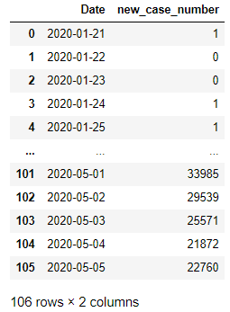
Dataset
iii. New case number of COVID-19 dataset in US
Format: (date, new case number)
Content: Daily number of new cases of COVID-19 in the United States between 01/21/2020 and 05/05/2020
Source: :https://github.com/nytimes/covid-19-data
Notes:
Finally, of course, we have daily new case number.

Slide 8
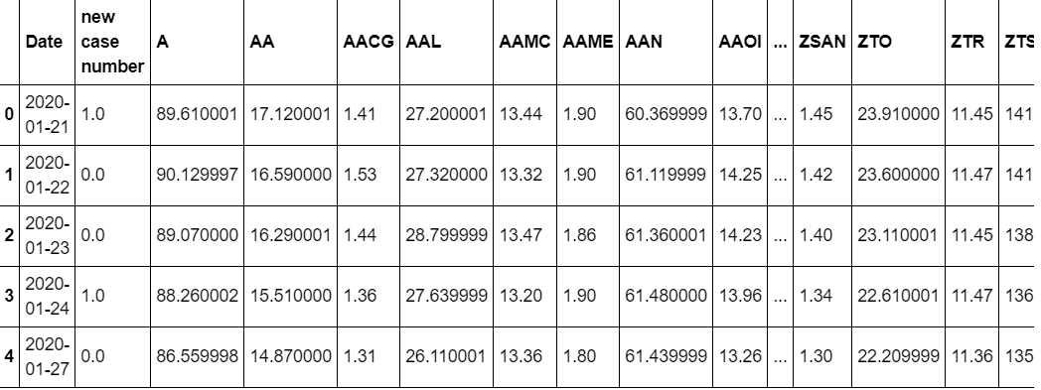
Merged data
Join the daily COVID-19 case data and the daily S & P 500 stock price data by date to obtain a new stock-case data set.
New format: (date, new case number ,stock ticker 1, stock ticker 2, …… , stock ticker 505)
Notes:
After we concatenate new case number and stock’s price, we get this schema. Then, we can compute the correlation and p-value between each column from A to ZTS and new case number column.

Slide 9
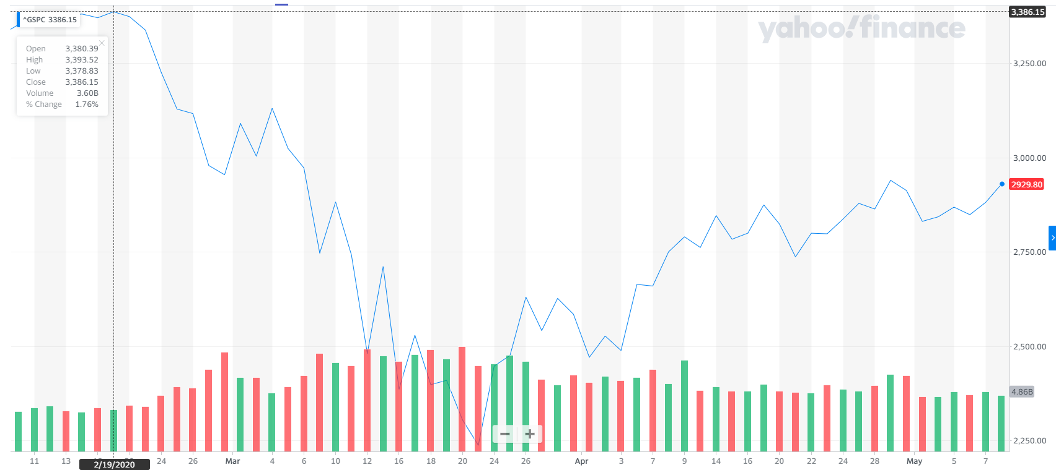
Analysis
i. Time interval selection
Through the data in the chart below, we find that the S & P 500 index has fallen sharply since February 19, 2020, and has been rebounding moderately since April 9, 2020. In addition, there were few new cases of COVID-19 before February 19, 2020, and after 04/09/2020, the new cases did not decrease, but the stock price rebounded.
This means that before and after this period, COVID-19 is not the main reason that affects the stock price. Therefore, we decided to set the time interval from 02/19/2020 to 04/09/2020.
Notes:
We search for the curve of S&P 500 index, we notice that it has fallen sharply since February 19th, and rebounded mildly since April 9th. So, this overall index’s performance tells us during the time other than this period, COVID-19 does not affect the stock market a lot. So, we narrow our interval to be from February 19th to April 9th.

Slide 10
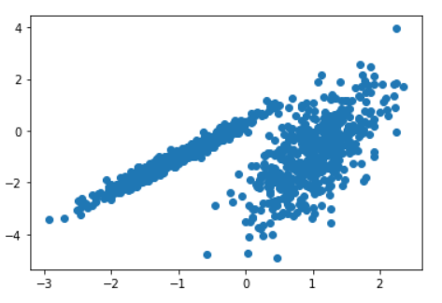
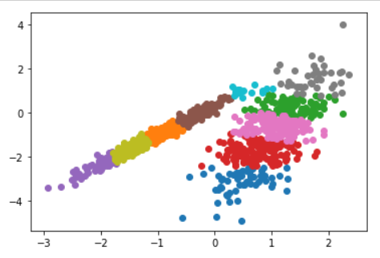
Analysis
ii. Mixture of Gaussian (MOG) Clustering
The Gaussian mixture model (GMM) assumes that the sample distribution is a linear weighted combination of k Gaussian distributions. By using the EM iterative algorithm, the probability of sample i belongs to the cluster j can be obtained.
The cluster with the highest posterior probability is taken as the clustering result of sample i.
Notes:
After computing the correlation and p-value of each stock, we want to use these two value as features to do classification. Stocks in the same class tend to perform similarly during the pandemic. Here I want to introduce a clustering method: Mixture of Gaussian. If we have some dots, which are shown as the left picture. Also, we have known there are 11 categories. MOG will tell the category of each dot, as you can see, in the right picture, dots with the same color belong to same cluster. Or same category. Similar to this example, we can draw the distribution of the stock with correlation and p-value. Then, we apply clustering model based on these 2 values.

Slide 11
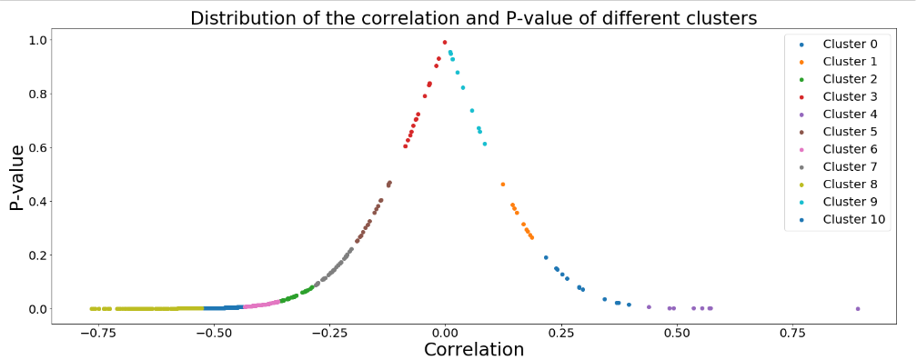
Analysis
iii. Correlation Distribution after Clustering
As shown above, each dot represents the correlation value together with the p-value between this stock’s price and the new case number.
Notes:
As you can see, every dot represents the correlation value of each stock and the corresponding p-value. Different colors represents different clusters. Intuitively, dots with correlation less than -0.25 are very dense, but dots with correlation larger than 0 are very sparse. This is consistent with our first mind: during pandemic, most companies are negatively impacted while few companies became the beneficiaries. But notice that dots around middle does not tell us much information between pandemic and stock’s price. Because only when p-value less than 0.05, we can say they are significant correlated.

Slide 12
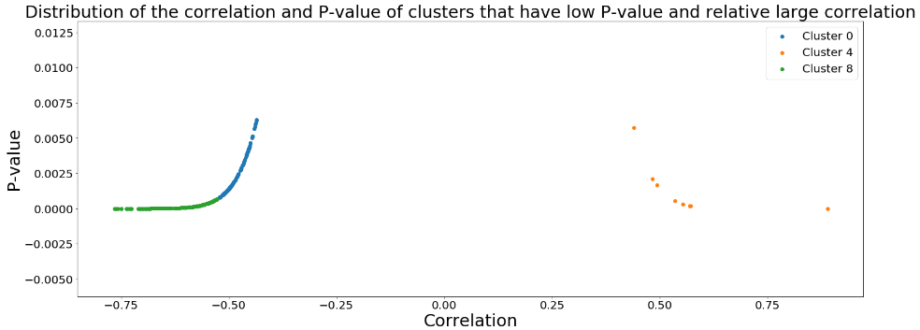
Analysis
iv. Clusters remained
We select the three clusters with small p-value and relative large correlation:
Notes:
So, we focus on stocks with low p-value, after filtering, only 3 clusters remain. The 2 leftmost clusters and the right most cluster. Now, we can take the left 2 clusters as stocks in them behaved similarly during the pandemic. Of course, the rightmost one is automatically one cluster, stocks in it are also stocks perform similarly during the pandemic. Now, we want to do some statistics in terms of the sector information.

Slide 13
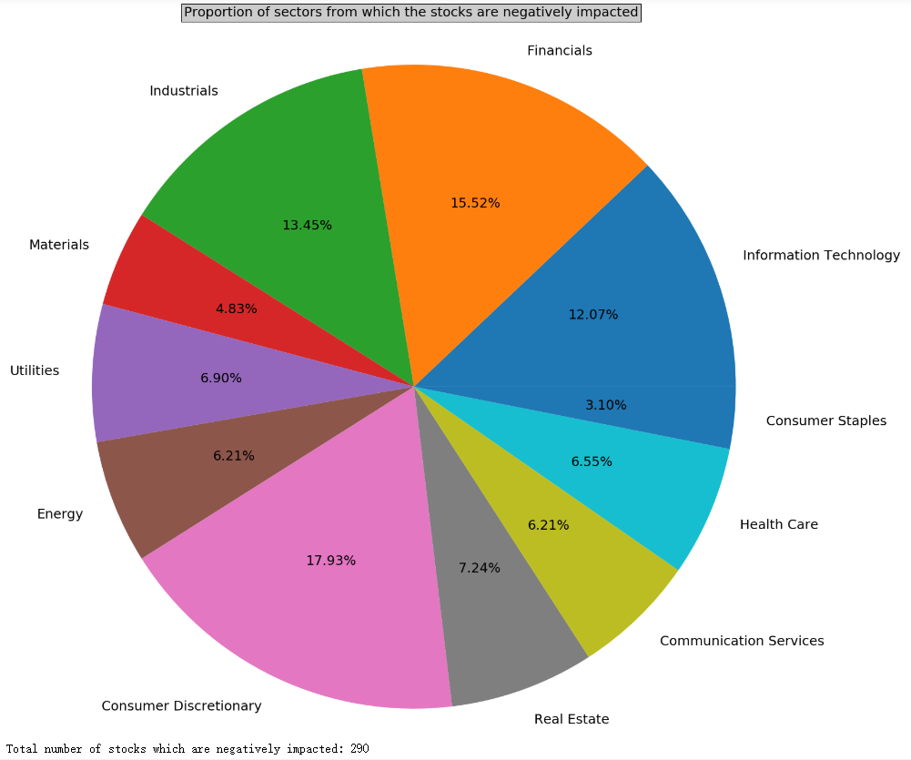
Findings
i. Proportion of sectors from which the stocks are negatively impacted
There are totally 290 stocks are negatively impacted in the clusters.
Among the stocks are most significantly negatively impacted by the pandemic, consumer discretionary, financials, industrials, information technology are top 4 sectors.
Notes:
We firstly compute the proportion of sectors from which the stocks are negatively impacted. As you can see, there are totally 290 stocks in our left 2 clusters. Among them, Consumer Discretionary, Financials, Industrials and Information technology are top 4 categories that tend to be negatively impacted during the pandemic.

Slide 14
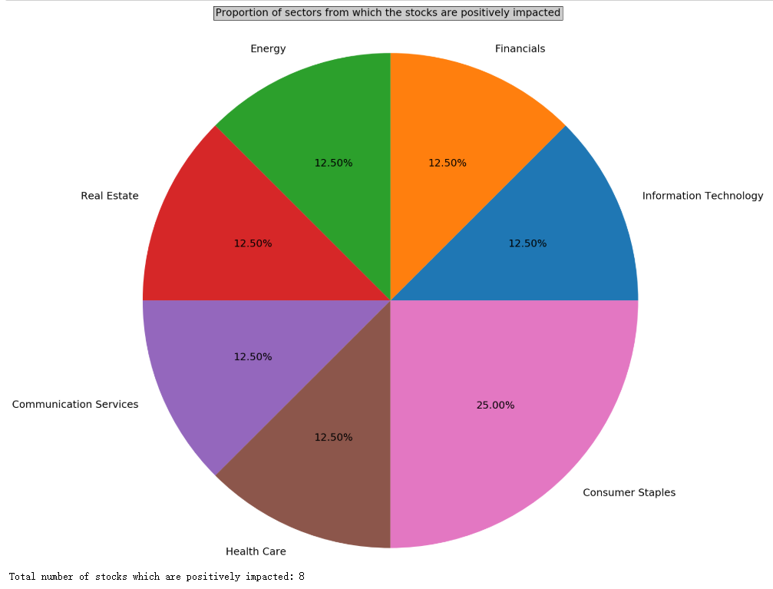
Findings
ii. Proportion of sectors from which the stocks are positively impacted
There are totally 8 stocks are positively impacted in the clusters.
There are 2 stocks belong to consumer staples, 1 health care, 1 real estate, 1 communication services, 1 energy, 1 financials, 1 information technology.
Notes:
There are only 8 stocks in our rightmost cluster, there are 2 Consumer Staples companies, 1 Health Care, 1 Communication Service, 1 Real Estate, 1 Energy, 1 Financials and one Information Technology.

Slide 15
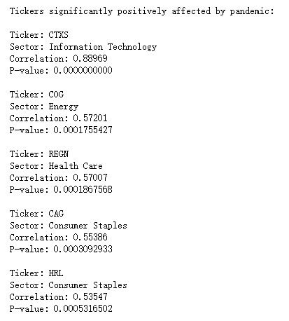
Findings
iii. Detail Findings
a. CTXS
Citrixis System, a information technology company. its digital workspace technology allows people to work in remote places with high level security has benefited the company.
b. COG
Cabot Oil & Gas, a company engaged in hydro-carbon exploration. There is no evidence that the rise of this stock is caused by the pandemic.
c. REGN
Regeneron Pharmaceuticals, a pharmaceutical company. During the COVID-19 epidemic, Regeneron made a deal with the US-government Biomedical Advanced Research and Development Authority.
d. CAG
Conagra Brands, an American packaged foods company. During the pandemic, consumers swarm stores to pick shelves clean of food items and essentials.
e. HRL
Hormel Foods Corporation is a food company. But there’s a plunge of this stock during the pandemic. So, this is another example that correlation does not mean causality.
15
Notes:
Now, we did some extra analysis in term of 5 stocks with highest correlation. For example, Citrix is an information technology company. You have notice that in our previous result, information technology company tends to be negatively impacted by the pandemic. But we see a strong positive correlation between Citrix and the pandemic. The reason is very simple and obvious: Citrix is a provider of digital workspace technology which allows people to work in remote places with high level security. During the Covid-19 pandemic many companies have no choice but let their employees work from home. Consequently, the market demand of Citrix’s products has surged. Of course, there are some other example with high correlation but no evident shows its rise came from the pandemic. So, we can say, sometimes, correlation doesn’t necessarily mean causality.
Of course, for companies are negatively impacted, we can do similar analysis.

Slide 16
Challenges and limitations
In the beginning, we planned to analyze stocks in NASDAQ, but we did not find the sector information of stocks. So, we switched to focusing on stocks in S&P 500.
The stock is affected in many ways, and the relationship between the number of new cases and the stock price will be disturbed by other factors, such as the international environment, government policies, and crude oil prices. We selected a short period of time for analysis to ensure the relevance of the data, but this reduced the number of valid data.
Our analysis uses some concepts and methods of mathematical statistics, but the distribution of the clusters does not necessarily follow the Gaussian distribution. If we introduce more features, the clustering may perform better.
Notes:
Now, let me conclude our project.
Firstly, we came across some difficulties in our project, at the beginning, we want to analyze stocks trading in NASDAQ, later on, we found we cannot find the sectors information, so, we switched to S&P 500.
Secondly, we only consider the pandemic, but stocks can be impacted by many factors. So, our results is in a manner give some guidance to investors but if we want to get more meaning results, we need to
consider more factors.
Finally, we applied clustering model but the distribution of the clusters does not necessarily follow the Gaussian distribution. If we introduce more features, the clustering model may perform better.

Slide 17
Thank you!
Notes:
That’s all, thank you!

